Slide 1
LADKRABANG COUNTRY
GROUP 11 – OOAD course, Fall 2015. CE KMITL
Let’s Get Started…

Slide 2

How well do you know KMITL?
If not well enough , we’ll present you…
Ladkrabang Country
App that make you understand KMITL better.
App that make you know where you are going.
App that make you up to date.
App that make you get everything you want.

Slide 3

Main Features
Log-in with facebook.
Post Announcement from admin.
locate main building in KMITL area.
Food and place review.
Can vote each reviews.
Locate transportation.
Locate yourself.

Slide 4

Special Features
Tag location.
Comment on each review.
Event sharing on social network.
Search review’s name.
Apartment zone.
Web board.
Count viewer.

Slide 5
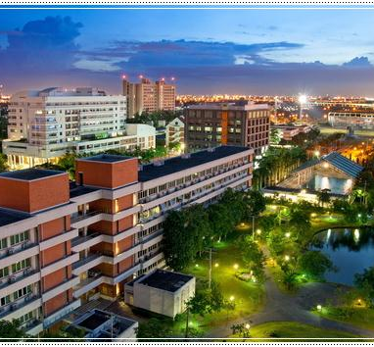
Why us?
The best design.
Easy to use.
Free in your thought.
Get new information.
Fun to use.
Share your favorite location.

